Slide 1




Capacity Allocation and Congestion Management for Electricity Network Code
ROME, 15th May 2012

Slide 2
Agenda
  The Regulatory Framework
  CACM network codes – Timescales
  Scope of network codes in the market area
  Scope of the CACM network code
  CACM network code – Capacity Calculation
  CACM network code – Bidding Zone
  CACM network code – Day ahead
  CACM network code – Intraday
  Supporting Documents to CACM network code

Slide 3
The Regulatory Framework
The CACM network code has been developed in accordance with the process established within the Third Energy Package (Regulation EC 714/2009). The legislation creates ENTSO-E and the Agency for the Coordination of Energy Regulators (ACER) and gives them clear obligations in developing network codes.
The process for developing network codes
Source: ENTSO-E

Slide 4
CACM network codes – Timescales
19 Sep 2011
Official request to start received
Sep 2011-Mar 2012
Drafting
Sep 2012
Deadline
Apr–May 2012
Jul-Aug 2012012
Jun 2012
Informal consultation
Public Consultation
Analyse, respond and update code based on comments
Finalise code
Source: ENTSO-E

Slide 5
Scope of network codes in the market area
Framework Guideline on Capacity Allocation and Congestion Management for electricity
Framework Guideline on Electricity Balancing (consultation launched)
Forward Market
Day ahead Market
Intraday Market
Balancing Market
To be tackled at a later stage
CACM Network Code
Subject of a separate code

Slide 6
Scope of the CACM network code
The CACM network code covers day ahead and intraday markets and a series of issues which will underpine the efficient operation of each of these markets
Day ahead markets
Intraday markets
Coordinated capacity calculation
Firmness Rules and rules for congestion income sharing
Cost Recovery Arrangements
Bidding zones configuration

Slide 7
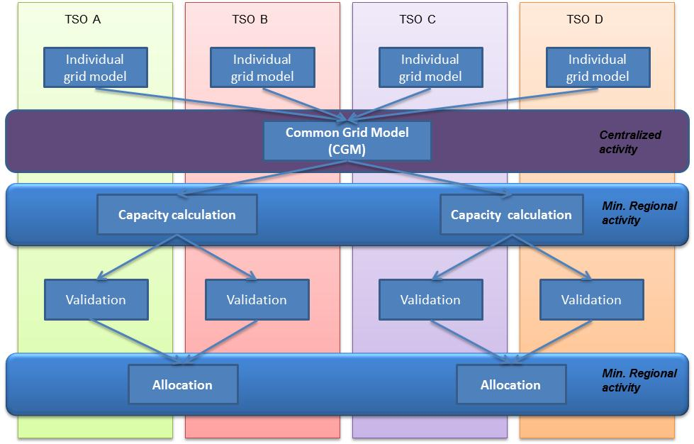
CACM network code – Capacity Calculation
The process
The Network Code allows using either Flow Based (FB) or Coordinated NTC Method for Day Ahead and Intraday timeframes
Source: ENTSO-E

Slide 8
CACM network code – Bidding Zone
Criteria to define bidding zone
Promotes efficient congestion management and secure network operation
Coordination
ENTSO-E considers that a coordinated process to study, propose and validate new bidding zone configurations shall be limited to cases where strong evidence of such coordination need exists
Process
A biennial report on current bidding zone configuration in order to identify if there is need to launch a regional process to study new bidding zone configuration
Enhances Social Welfare
Reflects structural congestion in the European network
Adequately takes into account adverse effects of internal transactions on other Bidding Zones
Consistent for all Capacity Calculation Timeframes
A regional study to identify new bidding zone configuration. Stakeholders will be consulted before the proposal is set for the National Regulatory Authority approval
Ensures that each generation and load unit shall belong to only one Bidding Zone for each Market Time Period
Sufficiently stable and robust over time

Slide 9
CACM network code – Day ahead
The target model
Market Coupling is the capacity allocation method chosen by ACER with the aim of enabling an efficient European wide price formation and an efficient use of the transmission grid.
The Day Ahead chapter of the CACM network code aims at establishing a common set of rules which can be applied across Europe in order to promote market coupling.
Under the Target Model one single matching algorithm is able to:
process bids and offers from market participants within local markets
deal with a series of constraints specified by TSOs
establish clearing prices and net positions for all bidding zones and
select cleared orders which are the orders accepted by the Price Coupling Algorithm
The algorithm needs to be capable of meeting clear objectives:
Orders collected in the various bidding zones should be accepted such that the economic surplus across the entire market coupling region is maximised.
When orders are transferred across bidding zones their overall amount must not exceed the cross zonal capacities between these zones.
Likewise, accepted bids have to comply with other network constraints specified by system operators.
The results of the price coupling Algorithm have to be available at a certain time specified by System Operators as a requirement to the price Coupling Algorithm.
While orders may be treated different for economically justifiable reasons there should be no undue discrimination between them.

Slide 10
CACM network code – Intraday
The target model
Continuous trading is the capacity allocation method chosen for the intraday timeframe
Source: ENTSO-E

Slide 11
CACM network code – Intraday
Key issues
Complementary regional auctions
Some prerequisites and conditions have to be fulfilled to ensure full compatibility with the wider EU solution
Explicit access to intraday capacity
Possibility to trade cross-border intraday electricity on OTC markets, until sophisticated products will be tradable via the continuous implicit trading platform. the removal of the explicit access will have to be preceded by a consultation of market stakeholders, however The deadline of 2016 is prescribed by CACM FWGL
Pricing of capacity
Two main cases have been so far identified where capacity may be priced: at gate opening when orders are already accumulated in the SOB before capacity is made available, and when orders have accumulated in the SOB due to the absence of cross-zonal capacity and new capacity is made available. We have refrained from proposing a concrete methodology in the network code, since on the one hand it is actually premature to precisely consent to one methodology and on the other hand a precise definition in the code may hamper further developments.

Slide 12
Supporting Documents to CACM network code
A non technical explanation of decisions
Frequently asked questions
An assessment against the FWGL
The supporting document:
Attempts to explain the code in a clear way and to aid transparency
Tries to meet the obligations placed on ENTSO-E by the EC
And demonstrate the FWGL is met
Source: ENTSO-E

